Slide 1
Schools and Medicaid Quarterly Call
February 28, 2017

Slide 2
Agenda
Introductions - AHCA and FDOE/SSS staff
FFS - Lakera/Luc
- Rule revisions/SPA status - Lakera/Luc
(FFS, charter/private schools/free care guidance)
- NCCI changes and affect on certified match program
- Status of research on denied behavioral claims
- Implementation OT/PT evaluation procedure codes
Monitoring-Jeffrey
SDAC - Ami
- Certifications
- when to certify
- sampled vs. non-sampled staff

Slide 3
Agenda (cont’d)
FDOE/SSS Update-Anne
- Parental consent forms-translated
- OT/PT conference call January 12
- Updated participation report posted
Tribute-Mary Ellen Barkman
NAME Conference-Deneen Gorassini, Conference Chair, Broward County school district
Open Forum-Call attendees enter questions in chat box

Slide 4
Fee for Service: Rule Revisions/SPAs - Status
Medicaid Certified School Match Handbook (2005)
Private/Charter Schools
Rules related to CMS Free Care guidance

Slide 5
Fee for Service-Denied Claims/New Procedure Codes
Denied behavioral claims over 8 units-procedure code
Status of FLMMIS accepting claims with new OT/PT evaluation procedure codes

Slide 6
Fee for Service-National Correct Coding Initiative
NCCI – Developed by CMS to promote national correct coding methodologies and to control improper coding leading to inappropriate payments.
MUE - NCCI includes a set of edits known as Medically Unlikely Edits (MUEs). An MUE is a maximum number of Units of Service allowable under most circumstances for a single Healthcare Common Procedure Coding System/Current Procedural Terminology (HCPCS/CPT) code billed by a provider on a date of service for a single beneficiary.

Slide 7
Fee for Service-National Correct Coding Initiative
MUE edits from 10/1/16:
- 96150 Behavioral-Individual Service- Evaluation-8 units
https://www.medicaid.gov/medicaid/data-and-systems/ncci/index.html

Slide 8
Medicaid Fee Schedules Effective 1/1/17
Medicaid Health Care Alert 2/7/17-Fee Schedules
http://ahca.myflorida.com/medicaid/review/fee_schedules.shtml
Sign up for Medicaid Health Care Alerts
http://ahca.myflorida.com/Medicaid/alerts/alerts.shtml

Slide 9
SDAC
Certifications
- when to certify
- sampled vs. non-sampled

Slide 10
SSS Website-Medicaid pages
SSS Website http://sss.usf.edu/resources/topic/medicaid/index.html
Parental Consent Forms translated-Spanish and Creole
Reminder: Send information for sharing with other districts

Slide 11
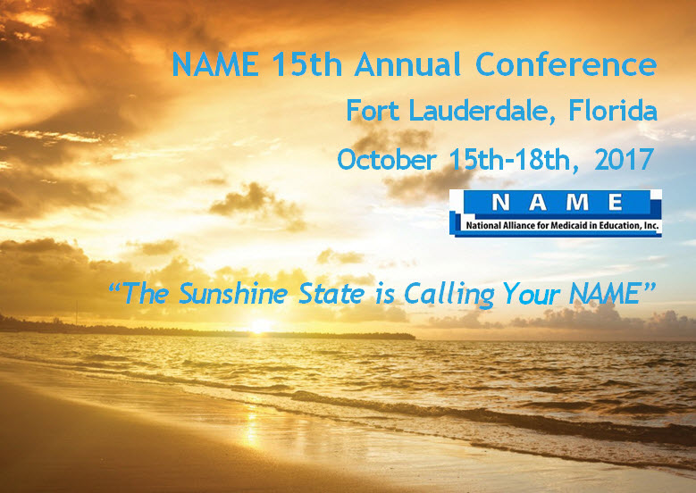
NAME Conference
October 15-18, 2017
Fort Lauderdale, FL

Slide 12
Open Forum
Phone will be taken off of presentation mode-please mute your phone line if you are not speaking
If you have comments or questions, please identify yourself and your district

